Slide 1

Block coding Developer
Session - 36
HTML Elements & Attributes

Slide 2


Recall
What we have learnt in last session?
What challenges you are facing?

Slide 3
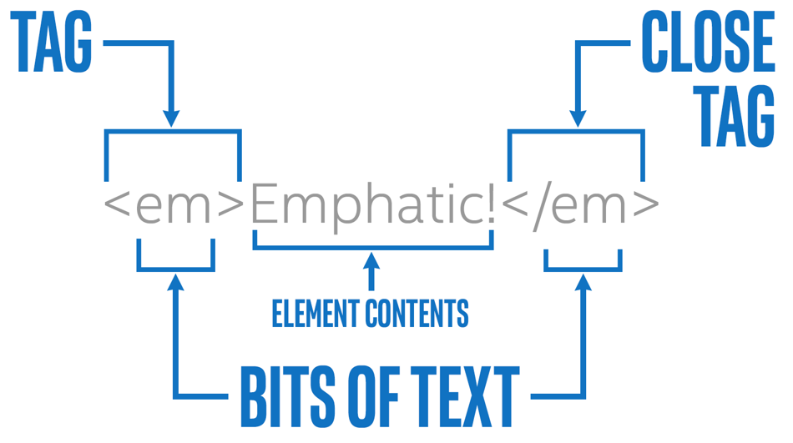
HTML Elements & Attributes
We will Learn today:
What is element?
What is Attribute?
Hyperlink

Slide 4
What is an Element?
An HTML element is a type of HTML document component
It is one of several types of HTML nodes.
HTML document is composed of a tree of text nodes, and HTML elements
It adds formatting to parts of document
Each element can have HTML attributes specified
An HTML element is defined by a start tag, some content, and an end tag
Start tag | Element content | End tag
<h1> | My First Heading | </h1>
<p> | My first paragraph. | </p>
<br> | none | none

Slide 5
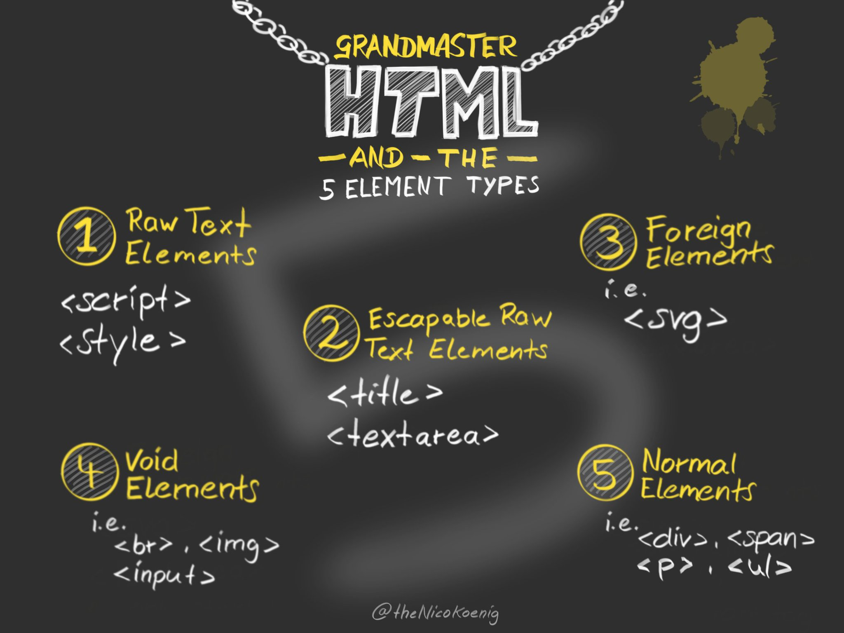
Kinds of Elements?
There are six different kinds of elements
Void elements
Raw text elements
Escapable raw text elements
Foreign elements
Normal elements

Slide 6
Kinds of Element?
Void Elements:
Can't have any content as there's no end tag and no content can be put between the start and end tag
Normal Element:
It can have text, character references, other elements, and comments
Void Elements
area, base, br, col, embed, hr, img, input, link, meta, param, source, track, wbr
All other allowed HTML elements are normal elements

Slide 7
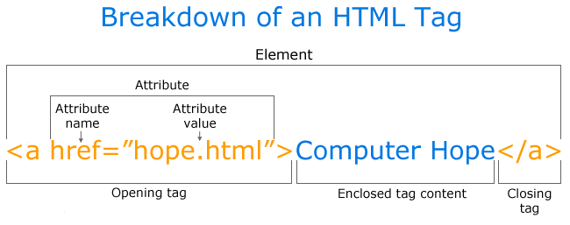
What are Attributes?
All HTML elements can have attributes
Attributes provide additional information about elements
Attributes are always specified in the start tag
Attributes usually come in name/value pairs like: name="value“

Slide 8
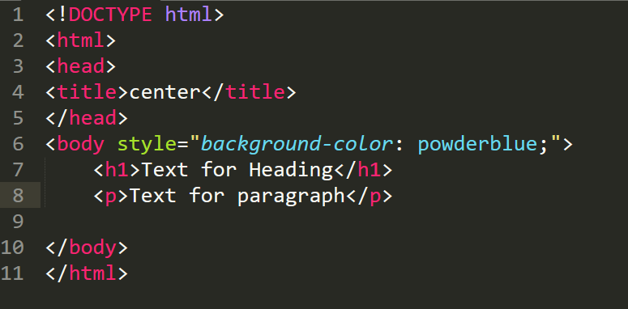
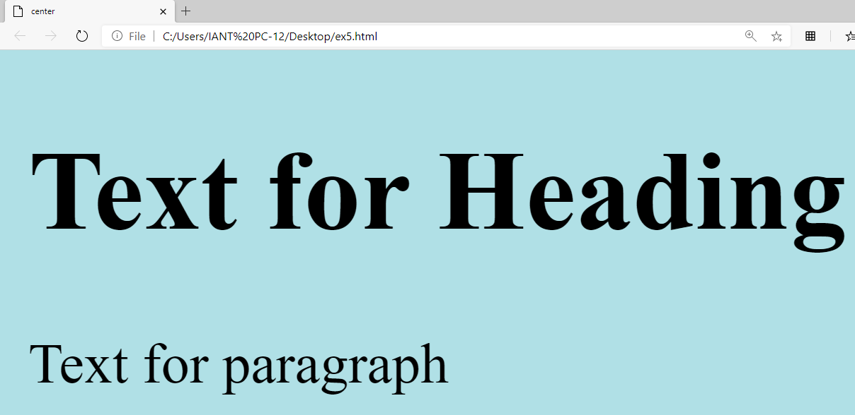
Background-color style Attribute…

Slide 9
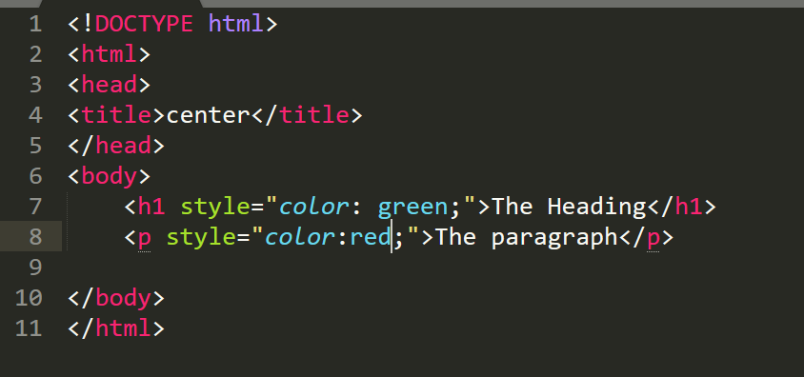
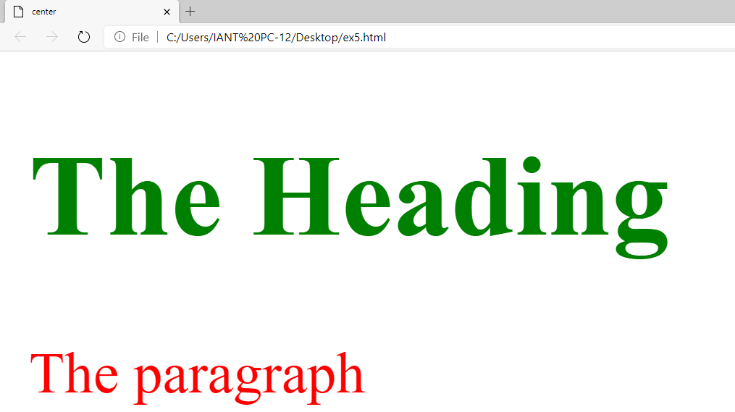
Text-color style attribute…

Slide 10
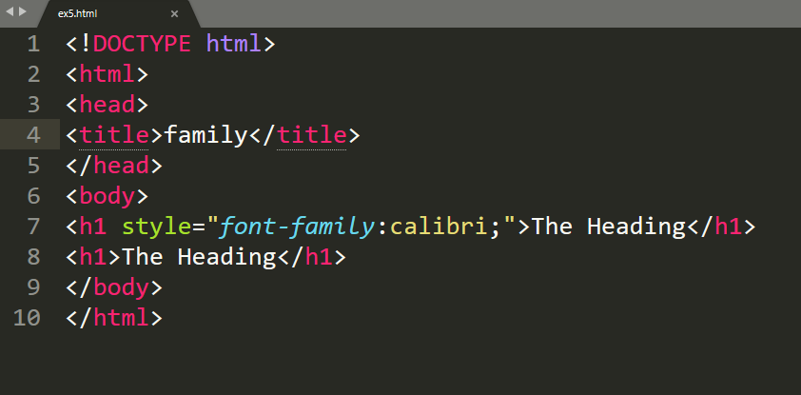
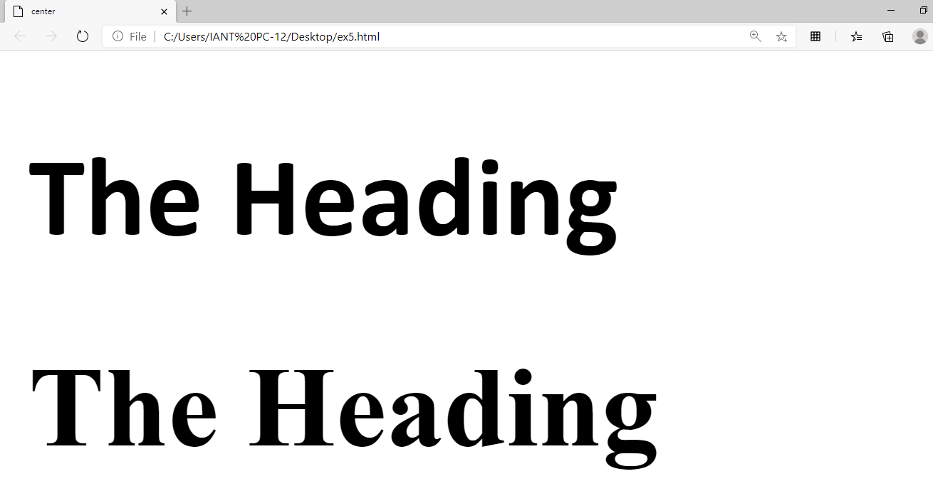
Font-Family style attribute…

Slide 11
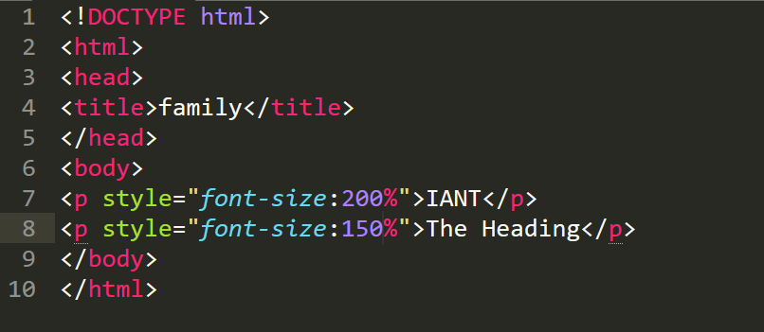
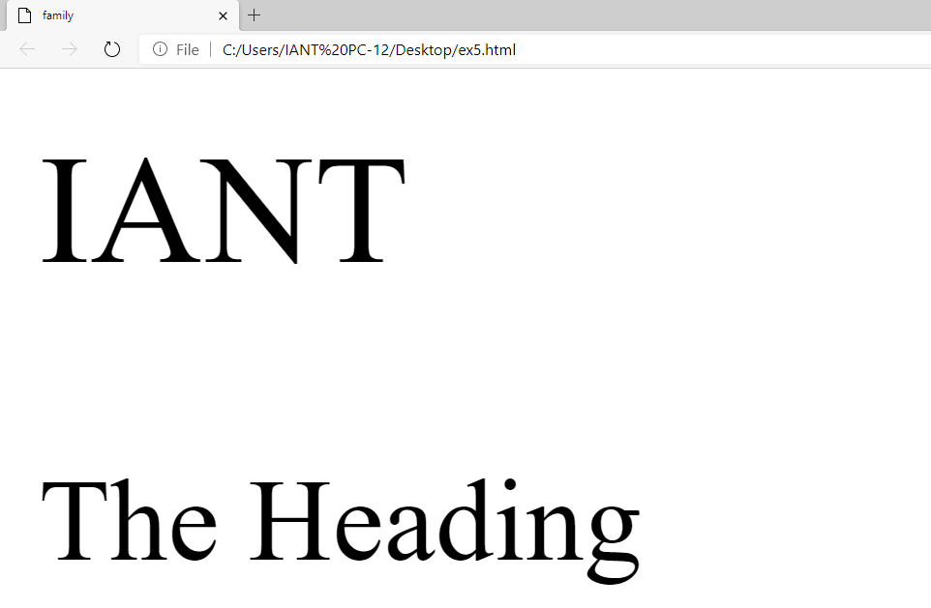
Text-size style attribute…

Slide 12
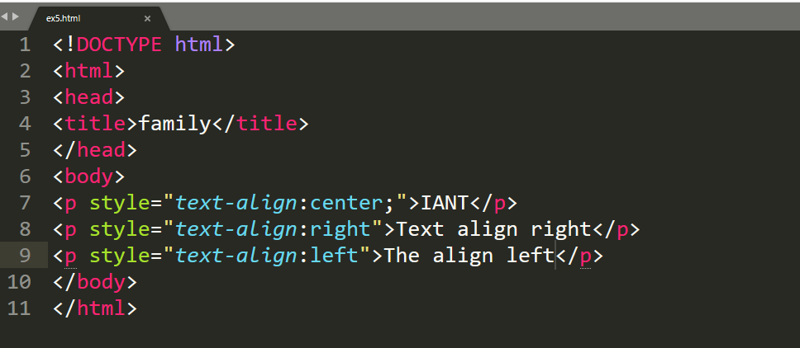
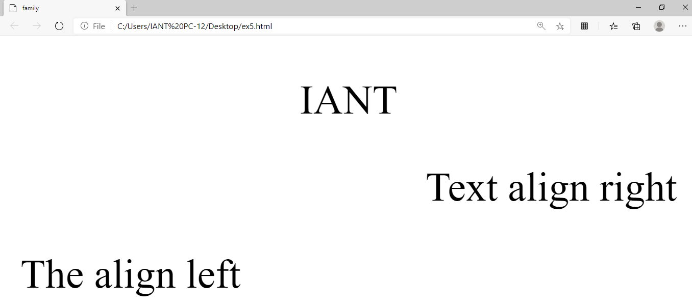
Text-alignment style attribute…

Slide 13
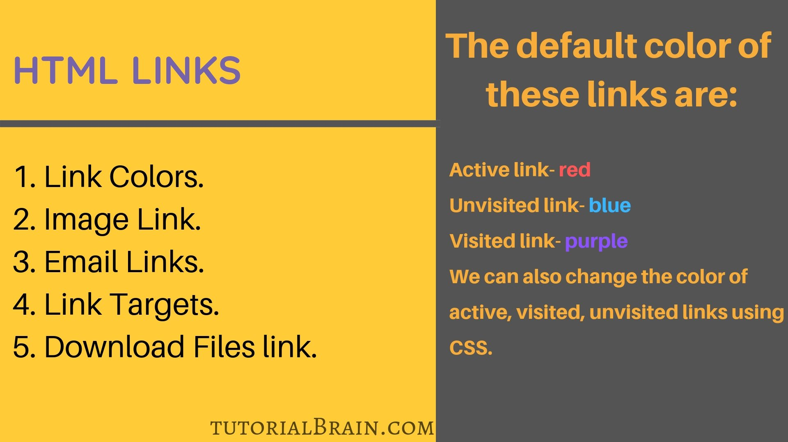
Hyperlink…
The most important attribute of the <a> element is the “href” attribute which indicates the links destination
You can click on a link and jump to another document
When you move the mouse over a link, the mouse arrow will turn into a little hand.

Slide 14
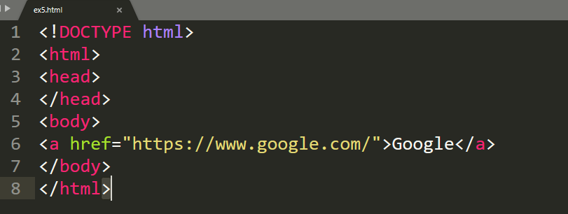
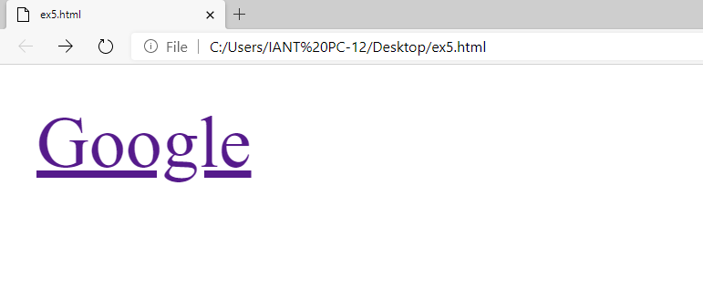
Example - Hyperlink…

Slide 15
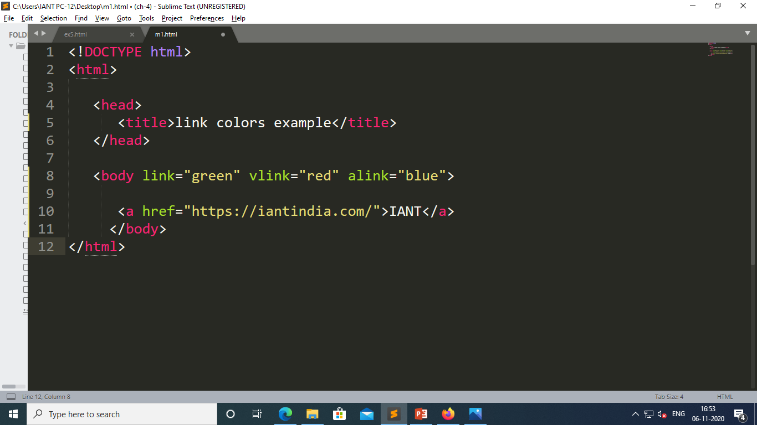
HTML Links - Different Colours…
By default, a link will appear like this (in all browsers):
An unvisited link is underlined and blue
A visited link is underlined and purple
An active link is underlined and red

Slide 16
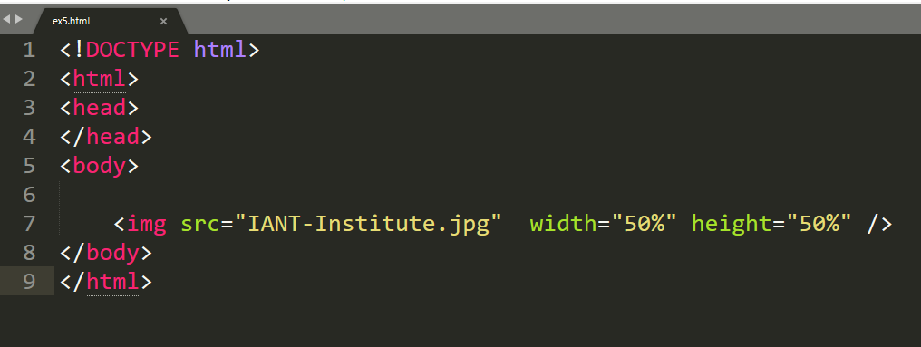

<img>Tag…
<img> tag are use to insert any image

Slide 17
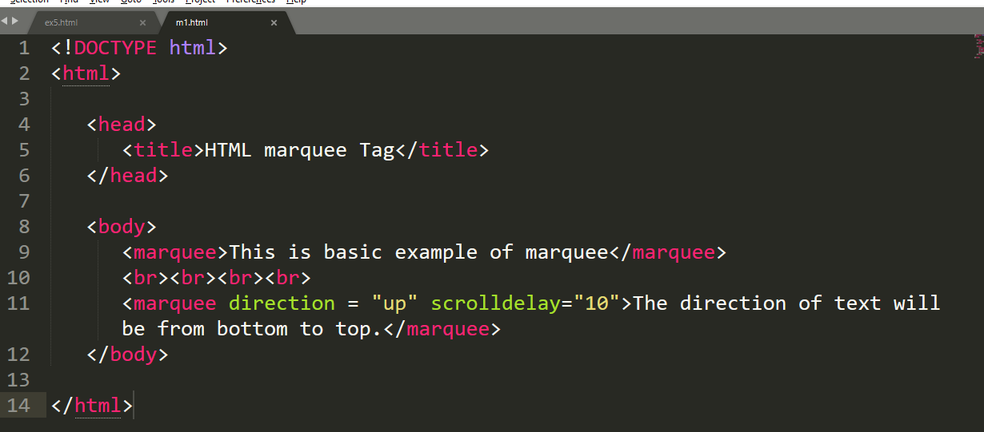
<marquee> tag…
It is used for scrolling piece of text or image displayed either horizontally across or vertically down your web site page depending on the settings
Direction attributes use properties - up, down, right, left

Slide 18

Summary…
What is element?
What is Attribute?
Hyperlink

Slide 19
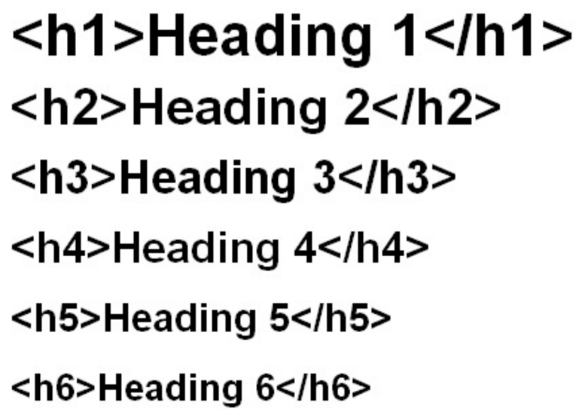
Next Session…
What is an Headings in HTML?
What are Paragraphs in HTML?
What we can do with Headings & Paragraphs?

